Slide 1
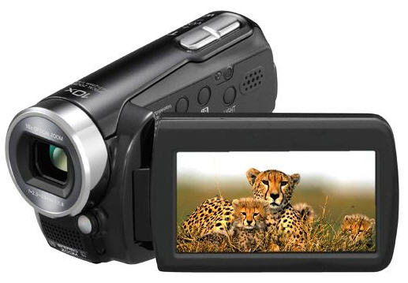
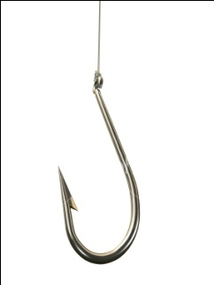

You are going to watch a short video clip on the Black Death. I hope you are listening carefully as I will be asking you questions about it!
black death

Slide 2

The Big Picture
Last lesson | This lesson | Next lesson
Buddhism | What caused the Black Death? | What were the results of the Black Death?

Slide 3

What caused the Black Death?
By the end of the lesson, you will understand:
What the Black Death was
What the symptoms of the Black Death were
By the end of the lesson, you will be able to:
Explain the features of the Black Death
Create a visual adaptation of the symptoms
Evaluate the causes of the Black Death
Write down the underlined words in bold!

Slide 4
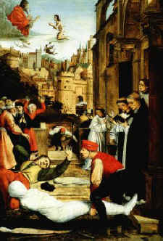
Input one
What was the Black Death?
People living in the medieval times always faced famine and disease, but in the middle of the 14th century they had to survive the Black Death. It spread from Asia to Europe and then to England, where nearly half of the population died. At the time, doctors did not know that germs caused diseases. However they had their own ideas about the Black Death.

Slide 5
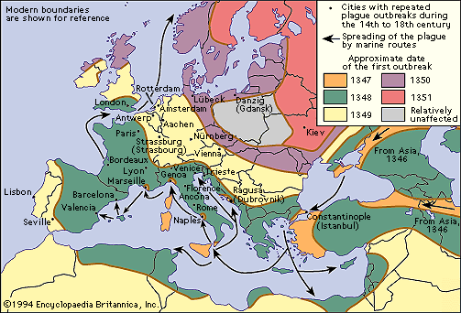
Where did the Black Death spread to?

Slide 6
Historians believe that there were two different plagues at this time:
Bubonic plague:
The germ is carried in the bloodstream by rats. Fleas which bite the rats become infected and then pass on the plague when they bite humans. These fleas multiply in the warm weather but die off in the winter. It takes 4-7 days to die.
Pneumonic plague:
This plague is caught through breathing. It attacks the lungs. Patients cough blood and spray out germs when they breathe out. It kills people within 2 days.

Slide 7
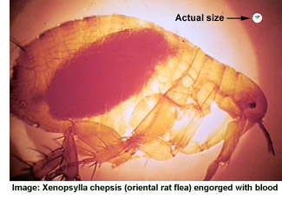
Scientists did not know the real cause, some blamed ‘corrupt air’ or the movements of the planets for the outbreak. Some people even thought that the Black Death was a sign of God’s anger.

Slide 8

Activity one
You are to explain the features of the Black Death in a short paragraph. Can you do it??

Slide 9
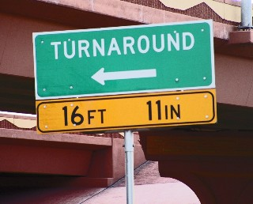
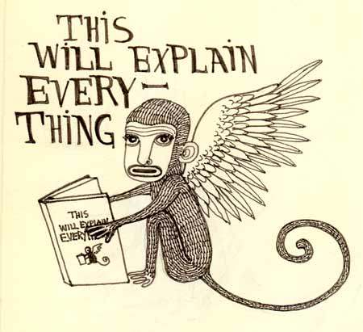
Review one
You are to turn around to the person behind you and tell them your explanation. Do they have anything you don’t or vice versa that you could add?

Slide 10
What caused the Black Death?
By the end of the lesson, you will understand:
What the Black Death was
What the symptoms of the Black Death were
By the end of the lesson, you will be able to:
Explain the features of the Black Death
Create a visual adaptation of the symptoms
Evaluate the causes of the Black Death

Slide 11
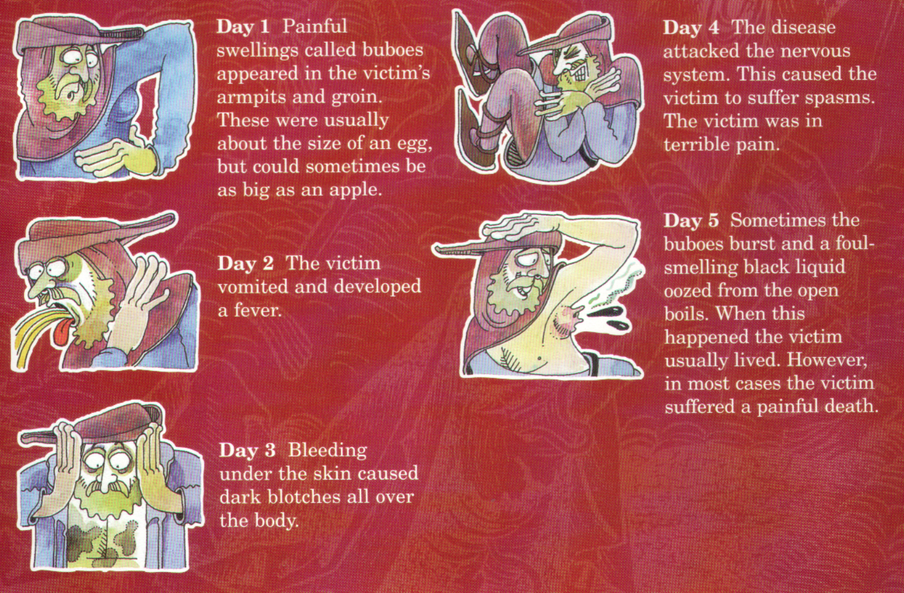
What were the symptoms of the plague?
Input two

Slide 12
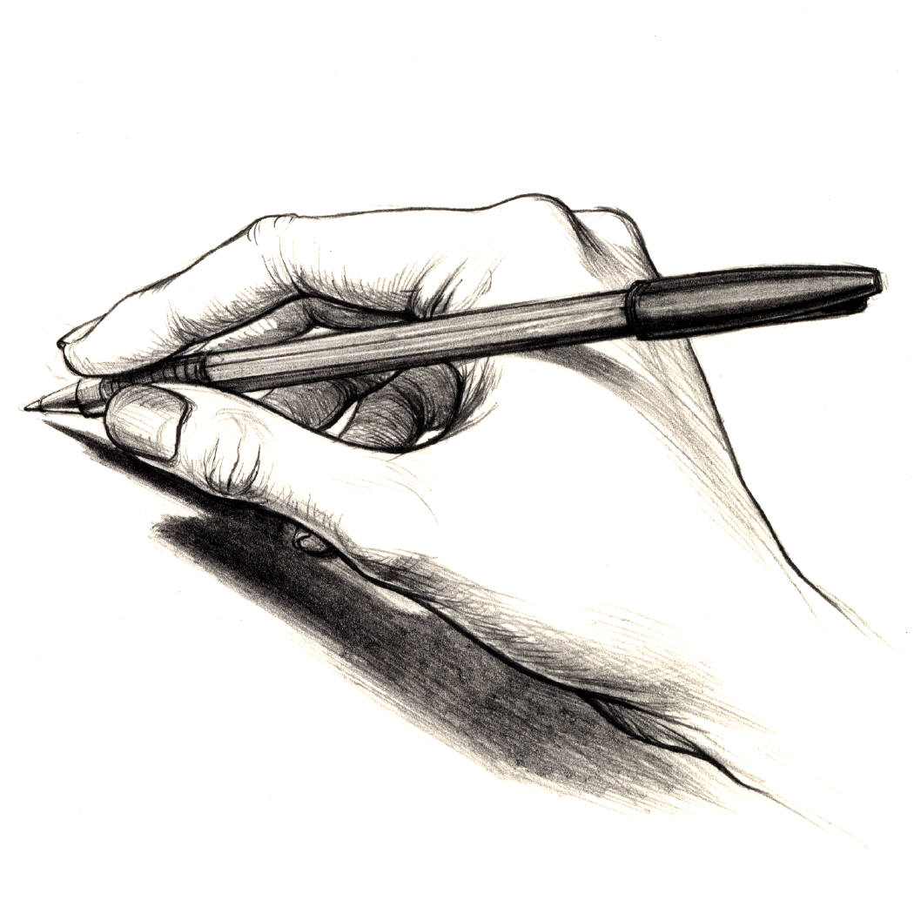
Activity two
You are to create a visual adaptation of the symptoms of the Black Death. You will need to draw a picture of a person and then label the symptoms of the Black Death. You are to accompany your drawing with a description of those symptoms.

Slide 13
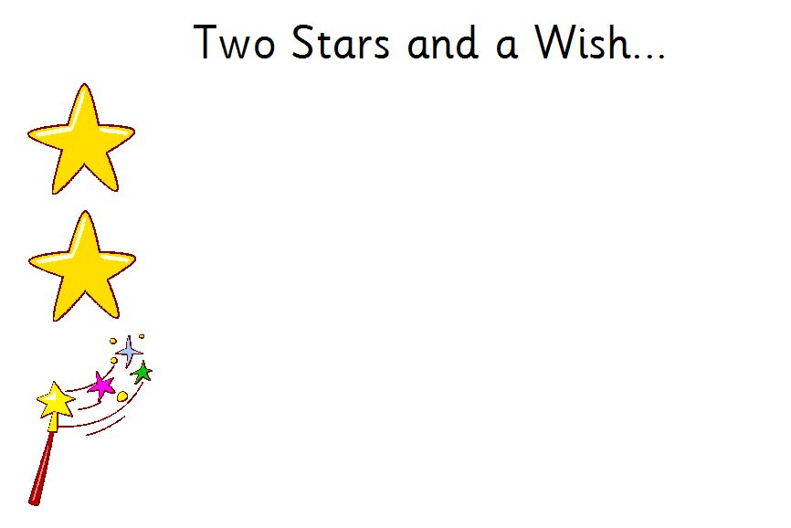
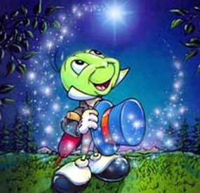
Review two
You are to swap books with the person sitting next to you. You are then to give them 2 stars and a wish for their work.

Slide 14
What caused the Black Death?
By the end of the lesson, you will understand:
What the Black Death was
What the symptoms of the Black Death were
By the end of the lesson, you will be able to:
Explain the features of the Black Death
Create a visual adaptation of the symptoms
Evaluate the causes of the Black Death

Slide 15
Input three
The Black Death caused huge loss of life and confusion in towns and countryside. During the Middle Ages, people mainly died through poor hygiene, dirty water supplies and common diseases. Monks and nuns treated the sick and operations were performed by barbers and travelling doctors. They could sew up wounds and make medicines. However they could not cure victims of the plague.
As precautions, people were told to:
Cover windows
Avoid sleeping on their backs
Breathe in toilet smells
Surprisingly, Britain recovered from the Black Death.

Slide 16

Activity three
Imagine you are a priest in a small village in Dorset at the time of the Black Death. You keep a diary in which you record its effects on your village. You are to include information about possible causes, symptoms, precautions and potential cures. You will need to ensure you evaluate the causes and what this meant to people.
Good Luck!

Slide 17

Review three
I will be choosing some of you at random to share your diary entry. I hope you are ready!

Slide 18
What caused the Black Death?
By the end of the lesson, you will understand:
What the Black Death was
What the symptoms of the Black Death were
By the end of the lesson, you will be able to:
Explain the features of the Black Death
Create a visual adaptation of the symptoms
Evaluate the causes of the Black Death

Slide 19


Imagine that people had mobile phones in the Middle Ages. The Black Death has arrived in your village. Text a friend in the neighbouring village warning them about the Black Death. The text message can be no more than 140 letters.

Slide 20

The Big Picture
Last lesson | This lesson | Next lesson
Buddhism | What caused the Black Death? | What were the results of the Black Death?

Slide 21


Consolidation Phase
Thumbs up/Thumbs down
By the end of the lesson, you will understand:
What the Black Death was
What the symptoms of the Black Death were
By the end of the lesson, you will be able to:
Explain the features of the Black Death
Create a visual adaptation of the symptoms
Evaluate the causes of the Black Death

